Slide 1


Slide 2

To Do
Connect with SQL Server Management Studio
Create Model

Slide 3
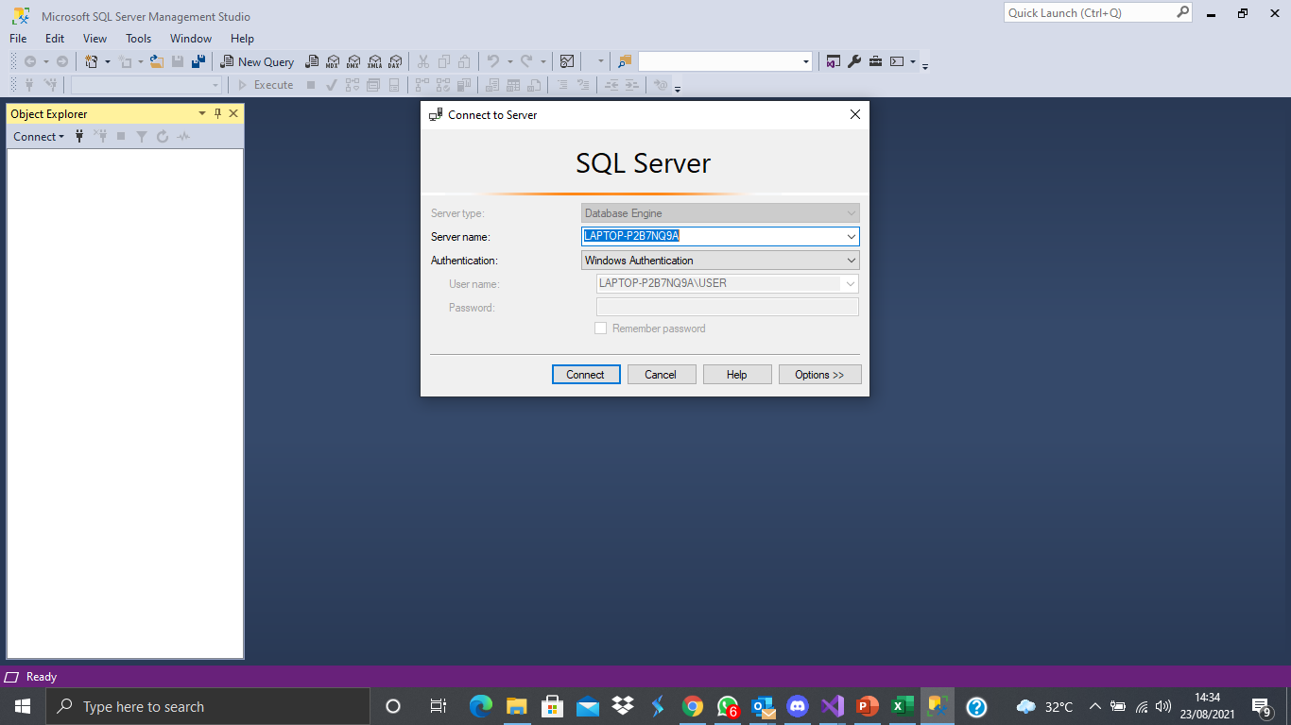
Connect with SQL Server Management Studio
Open your SQL Server Management Studio apps, and click connect.

Slide 4
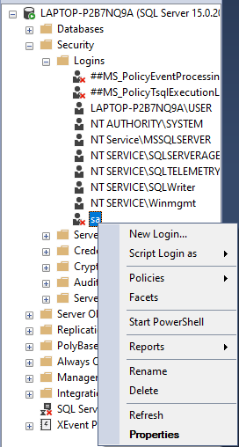
Click on security folder, click login. Right click on sa (the bottom one), choose properties

Slide 5
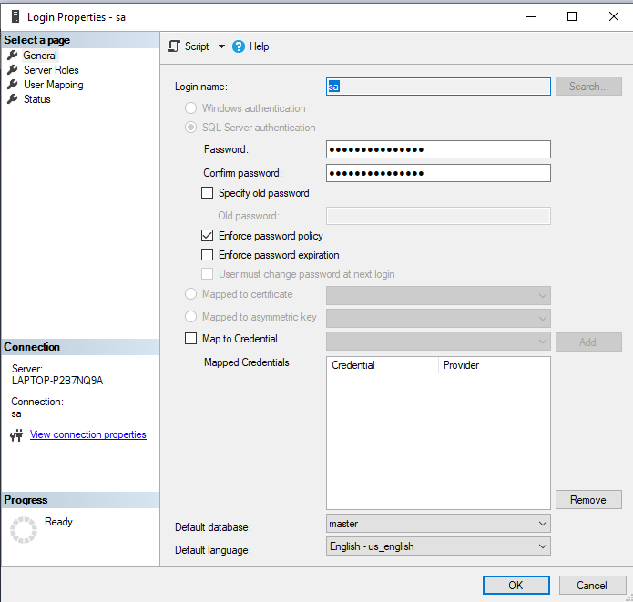
On the general tab, Fill the password with “sapassword”

Slide 6
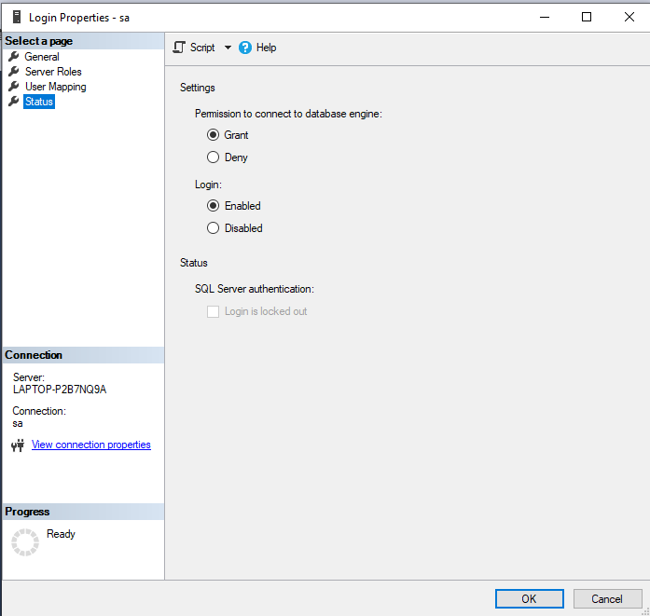
On status tab, click enabled. Then click Ok.

Slide 7
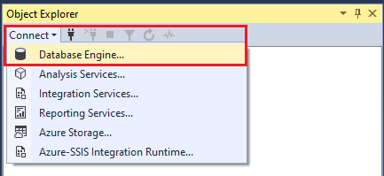
After that, click on connect, choose database enginge

Slide 8
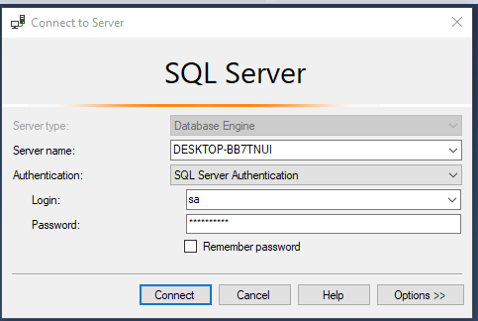
Change the authentication to SQL Server Authentication. Fill the username and password

Slide 9
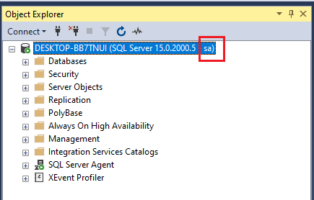
If it’s successful, it will look like this

Slide 10
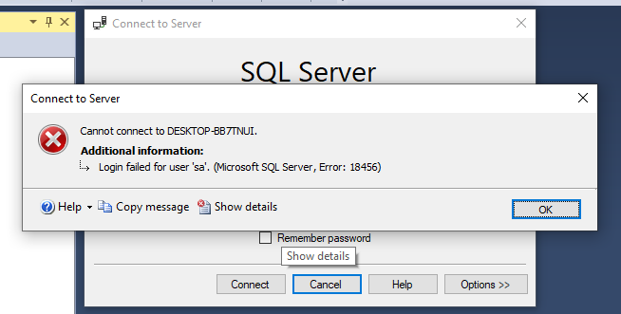
If error like this appeared

Slide 11
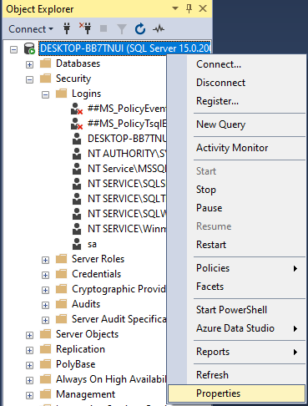
right click on the connection. Click Properties

Slide 12
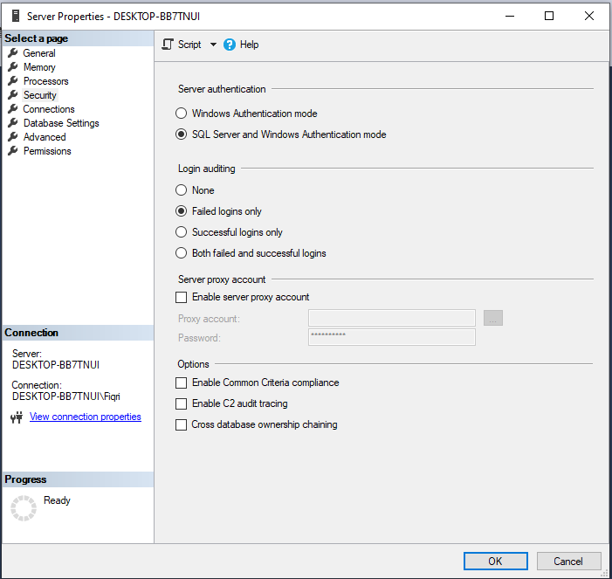
Go on tab security, and select the SQL Server and Windows Authentication Mode

Slide 13
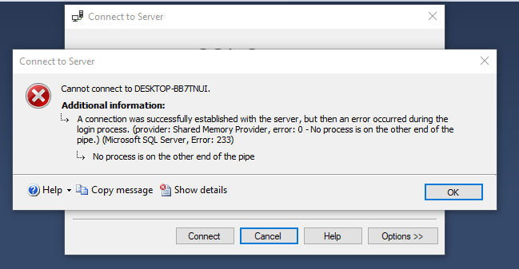
If error like this appeared, hold windows + r, type services.msc. Restart SQL Server Agent

